Slide 1

Network Topologies
Associate Professor
Department of Computer Science and Engineering

Slide 2
Topics of Discussion
Network
Type of Connections
  Point-to-point
  Multipoint
Network Topologies
  Physical Topology
  Logical Topology
  Mesh
  Star
  Bus
  Ring
  Hybrid
  Tree
Notes:
1.#

Slide 3
NETWORK
A network is a set of devices (often referred to as nodes) connected by communication links.
A node can be a computer, printer, or any other device capable of sending and/or receiving data generated by other nodes on the network.
A link can be a cable, air, optical fiber, or any medium which can transport a signal carrying information.
Notes:
1.#

Slide 4
Type of connections
  1. Point to Point - single transmitter and receiver
    Dedicated link: The term dedicated means that the link carries traffic only between the two devices it connects.
    Entire capacity of the link is reserved for transmission
  2. Multipoint - multiple recipients of single transmission
Notes:
1.#

Slide 5

Figure 1 Types of connections: point-to-point and multipoint
Dedicated link between two devices
Several devices can use the link simultaneously or time-shared
(spatially or temporally)
Notes:
1.#

Slide 6
Topology
Two or more devices connect to a link; two or more links form a topology.
The topology of a network is the geometric representation of the relationship of all the links and linking devices/nodes to one another.
  Physical Topology
  Logical Topology
Physical Topology:
Refers to the way in which a network is laid out physically
How devices are actually interconnected with wires and cables.
Logical Topology:
A logical topology is how devices appear connected to the user.
Notes:
1.#

Slide 7

Figure 2 Categories of topology
Hybrid topology
Tree topology
Notes:
1.#

Slide 8

Figure 3 A fully connected mesh topology (five devices)
1. Mesh Topology: In a mesh topology, every device has a dedicated point-to-point link to every other device.
N3
Node1 is connected to N-1 nodes
Node2 is connected to N-1 nodes
N2
….
Node N is connected to N-1 nodes
No. of physical links N(N-1)
In duplex mode: No. of links N(N-1)/2
N4
LINK
Every device on the network must have n – 1 input/output ports to be connected to the other n- 1 stations.
N1
N5
Data Packet
Notes:
1.#

Slide 9
Mesh Topology: Pros & Cons
Advantages | Eliminating the traffic problems
 | Robust
 | Privacy and security
Disadvantages | Installation and reconnection are difficult
 | Wiring can be greater than available space
 | Expensive hardware
Practical example: Telephone regional offices
Notes:
1.#

Slide 10

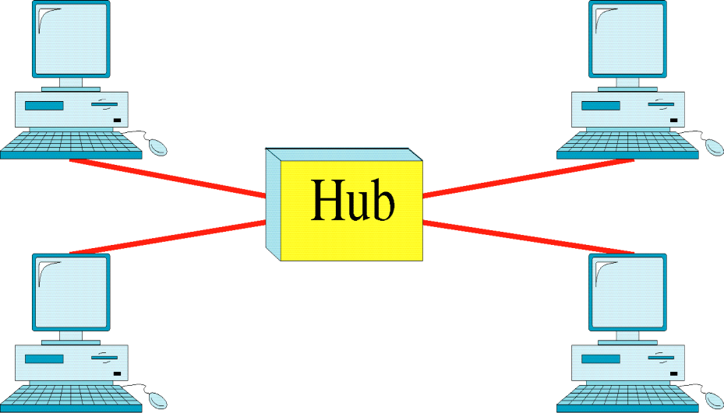
Figure 4 A star topology connecting four stations
2. Star Topology: In a star topology, each device has a dedicated point-to-point link only to a central controller (hub)
Notes:
1.#

Slide 11
Star Topology: Pros & Cons
Advantages | Less expensive than mesh topology
 | Each device needs only one link and one I/O port
 | Easy to install and reconfigure
 | Less cabling
 | Robustness
Disadvantage | Dependency of the whole topology on one single point, the hub
The star topology is used in local-area networks (LANs)
Notes:
1.#

Slide 12

Figure 5 A bus topology connecting three stations
3. Bus Topology: Nodes are connected to the bus cable by drop lines and taps.
A drop line is a connection running between the device and the main cable.
A bus topology is multipoint.
Mesh and star are examples of point-to-point connections.
Notes:
1.#

Slide 13
Bus Topology: Pros & Cons
Advantages | Ease of installation
 | Less cabling than mesh or star topologies
Disadvantages | Difficult reconnection and fault isolation
 | Signal reflection at the taps can cause degradation in quality.
 | A fault or break in the bus cable stops all transmission
Ethernet LANs can use a bus topology.
Notes:
1.#

Slide 14

Figure 6 A ring topology connecting six stations
4. Ring Topology: In a ring topology, each device has a dedicated point-to-point connection with only the two devices on either side of it.
Notes:
1.#

Slide 15
Ring Topology: Pros & Cons
Advantages | Easy to install and reconfigure
 | Fault isolation is simplified
Disadvantages | Unidirectional traffic
 | In a simple ring, a break in the ring (such as a disabled station) can disable the entire network. → Troubleshooting is difficult
Ring topology was prevalent when IBM introduced its local-area network Token Ring in the middle 1980s.
Token Ring had a "Star Ring" topology.
Token ring networks were physically similar to a star topology in appearance, but logically wired as a Ring Topology.
Notes:
1.#

Slide 16

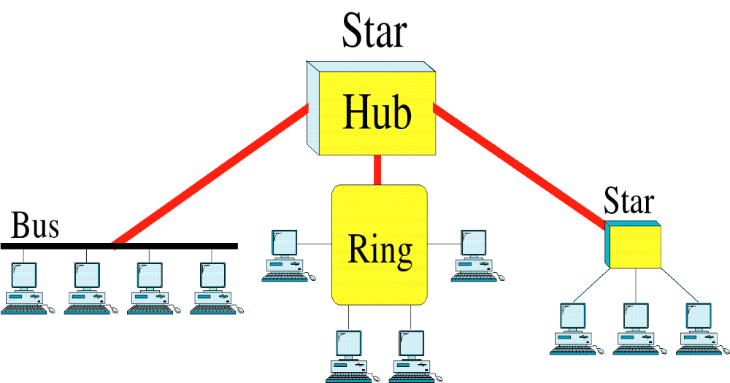
Figure 7 A hybrid topology: a star backbone with three bus networks
5. Hybrid Topology: This topology is a collection of two or more topologies.
Notes:
1.#

Slide 17
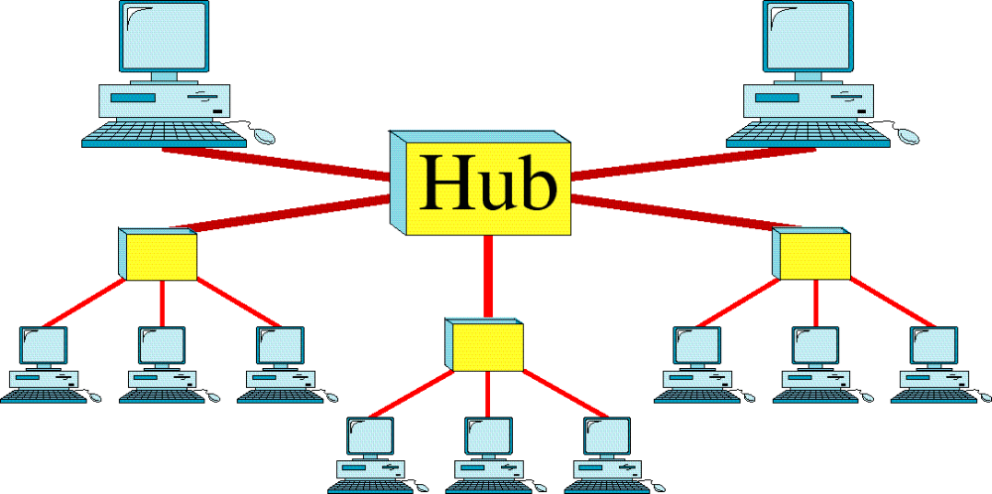
Figure 8 A tree topology
6. Tree Topology: A tree topology (hierarchical topology) is a collection of star networks arranged in a hierarchy.
Notes:
1.#

Slide 18
_x0010_Thank You
Notes:
1.#

